Slide 1


Purple Air Sensor Data Retrieval
Internship Presentation
Mehdi BIMAGHRA

Slide 2
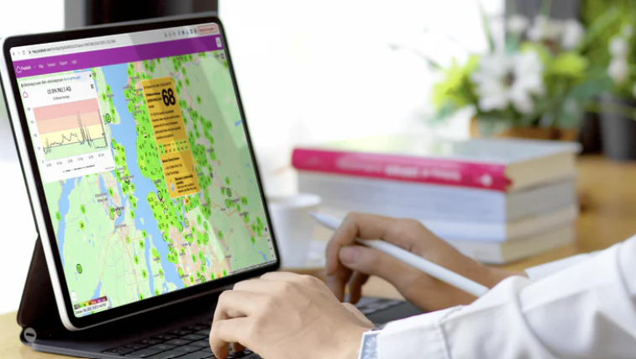
The Purple Air Project - Maintain Air Quality
Notes:
PurpleAir is a community system of low-cost sensors measuring particulate matter. Particulate matter describes solid particles suspended in air, including dust, smoke, pollen, and other organic and inorganic particles.
The PurpleAir system is composed of many sensors that are installed, controlled and maintained by members of the community.

Slide 3

Introduction
Notes:
*The following code retrieves sensor data from the PurpleAir API.
*It involves making API calls to gather air quality information from specified sensors.
*The data is then processed and organized for further analysis.

Slide 4
Code Overview
The code uses Python and libraries such as Pandas and Requests.
It is designed to fetch historical air quality data from PurpleAir sensors.
The retrieved data is then processed and stored in an organized manner.
Notes:
This Python script is a handy tool for getting air quality data from PurpleAir sensors. It lets users choose specific sensors, pick a date range, and select the data they want, like humidity or temperature. The script then organizes and saves the data neatly. It creates a folder called 'NewData' where it saves information for each day, and inside that, it keeps separate CSV files for each sensor. This makes it easy for users to find and use the data they need. The script also checks for errors when getting the data and tells users if something went wrong. In short, it's a user-friendly way to collect and store PurpleAir sensor data for analysis.

Slide 5
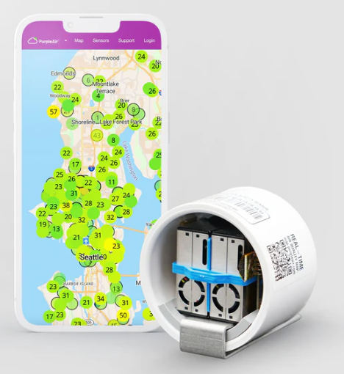

API Key
An API key is crucial for accessing PurpleAir data securely.
In this code, the API key is included in the headers for authentication.

Slide 6

Folder Creation
A new folder is created to store the retrieved sensor data.
This ensures a systematic organization of information.

Slide 7
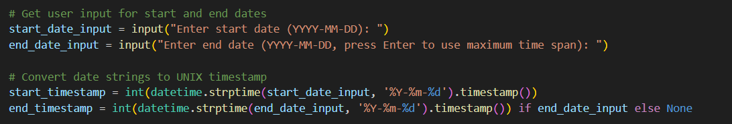
User Input
User input is required for defining the time span of data retrieval.
Start and end dates are converted to UNIX timestamps for API queries.

Slide 8
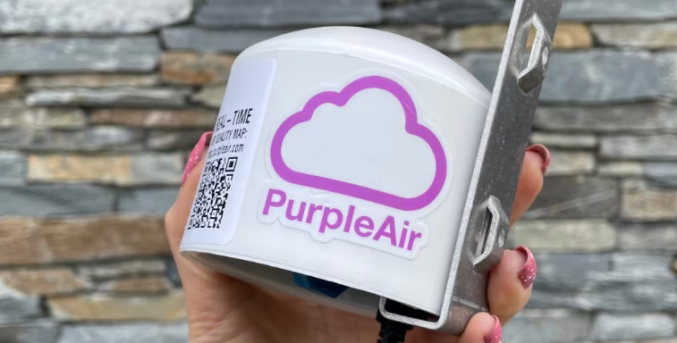
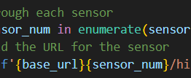
Sensor Loop
The code iterates through a list of sensors, each identified by a unique number.
For each sensor, API calls are made to retrieve historical air quality data.

Slide 9
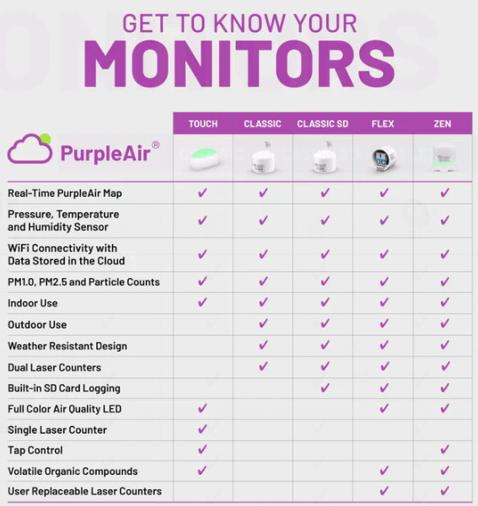

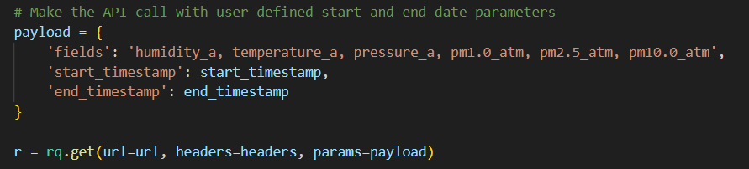
API Call
API calls are made to PurpleAir's endpoint for sensor history in CSV format.
Parameters such as fields, start timestamp, and end timestamp are defined for the API call.

Slide 10
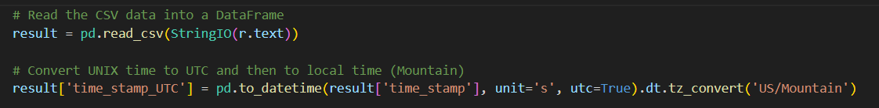
Data Processing
CSV data from the API response is processed using Pandas into a DataFrame.
UNIX timestamps are converted to local time (Mountain time zone) for readability.

Slide 11
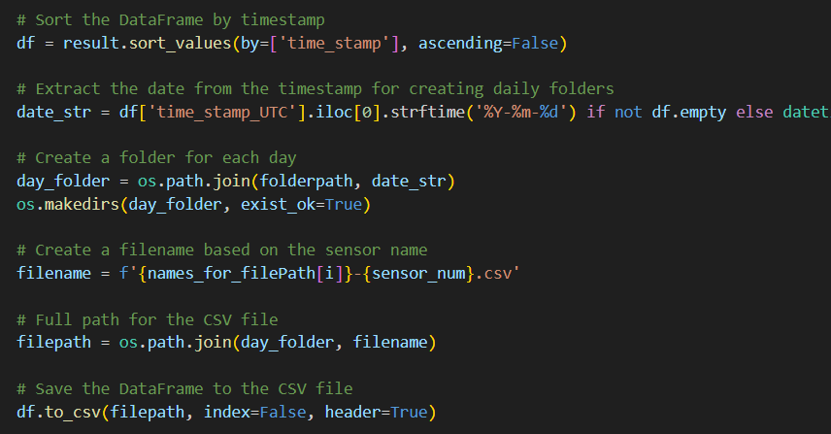

Data Sorting and Saving
DataFrames are sorted by timestamp for chronological order.
Data is saved in CSV files, organized into daily folders based on the timestamp.

Slide 12

Error Handling
The code includes checks for successful API calls
Notes:
If a call fails, an error message is printed indicating the failure and status code.

Slide 13
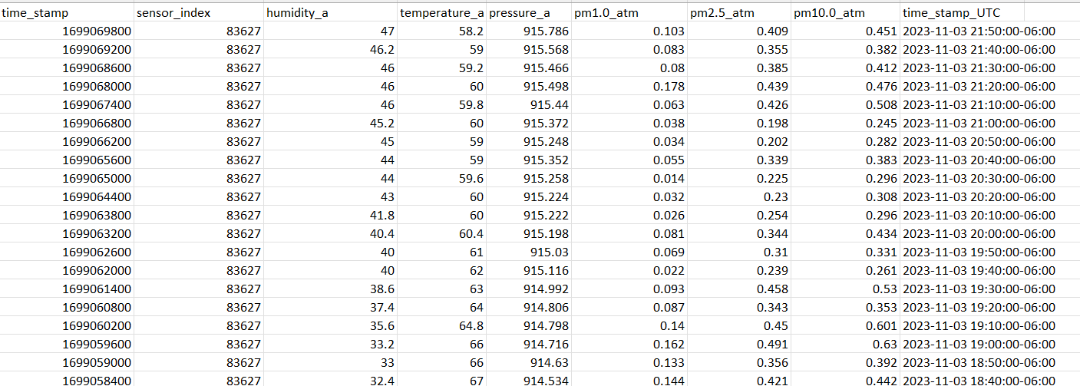
Results

Slide 14

Benefits
Streamlines and automates part of the workflow
Allows for quick and easy storage of PurpleAir data.

Slide 15

Future Directions
Automate this code as a background process.
Create a UI interface and run the service as a web app.

Slide 16
Conclusion
Notes:
The code efficiently retrieves and organizes air quality data from PurpleAir sensors.
It provides a foundation for further analysis and exploration of air quality patterns.

